Slide 1

UNSUPERVISED METHODS TO GROUP USERS’ CONSUMPTION BEHAVIOUR TO ENHANCE PERSONALIZE SERVICE DEGRADATION POLICIES
PROJECT MODULE 1
ROBERTO CASALUCE – MACIEJ ZUZIAK

Slide 2

EXPLORATORY DATA ANALYSIS AND FEATURE ENGINEERING

Slide 3




OVERVIEW
ONE DATASET CONTAINING 1249 STATISTICAL UNITS
114 DIFFERENT FEATURES (ONLINE PLATFORMS AND MOBILE APPLICATIONS)
TIME EXPRESSED IN SECOND, DATA CONSUMPTION IN BYTES
TASK IS TO IDENTIFY THE EXISTENCE OF CONSUMER GROUPS

Slide 4
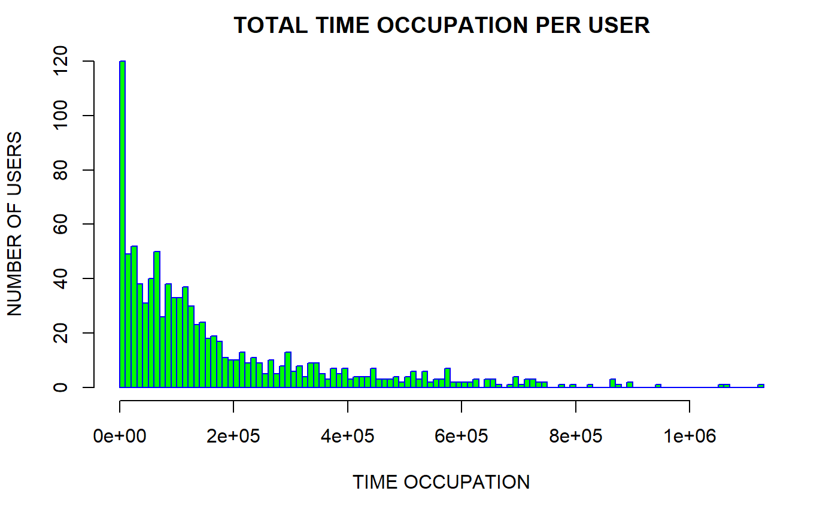

Slide 5
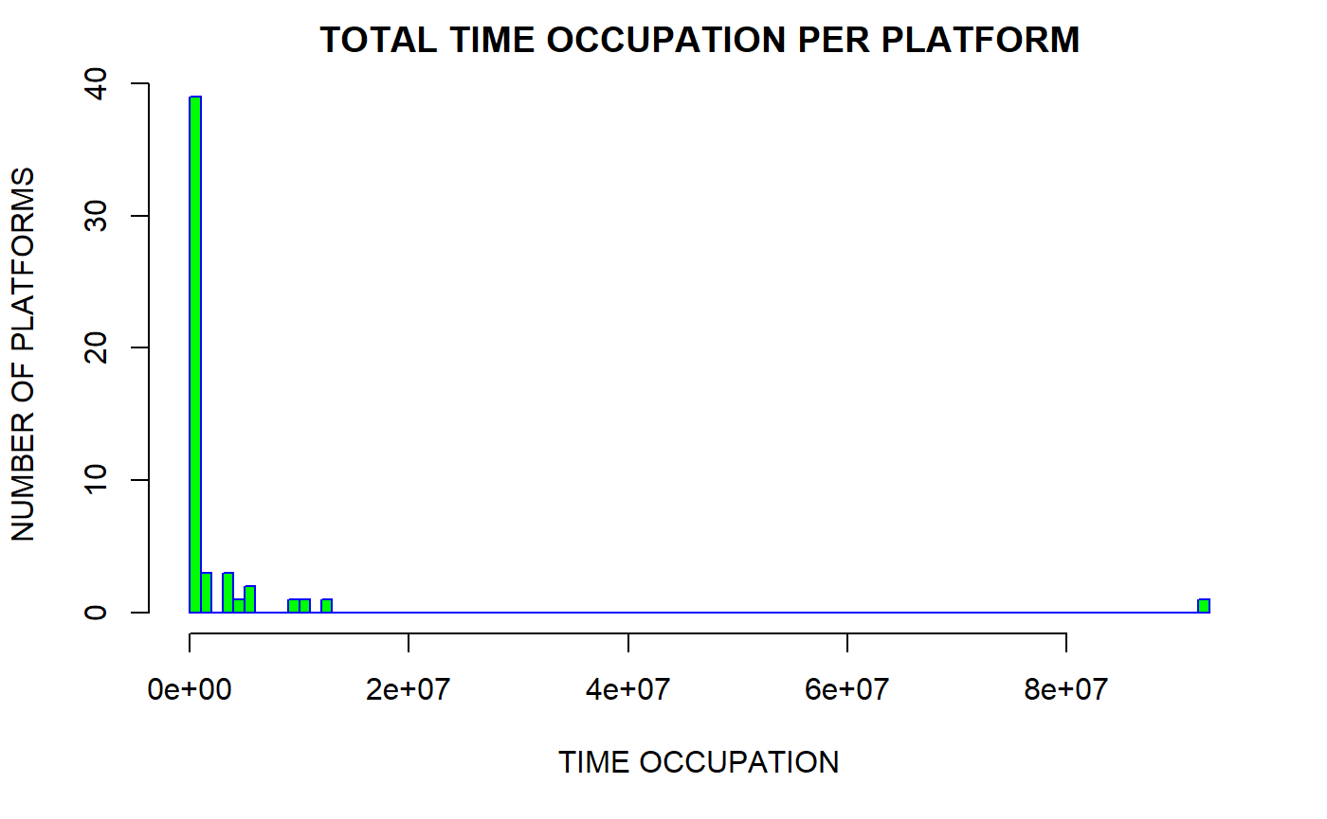

Slide 6
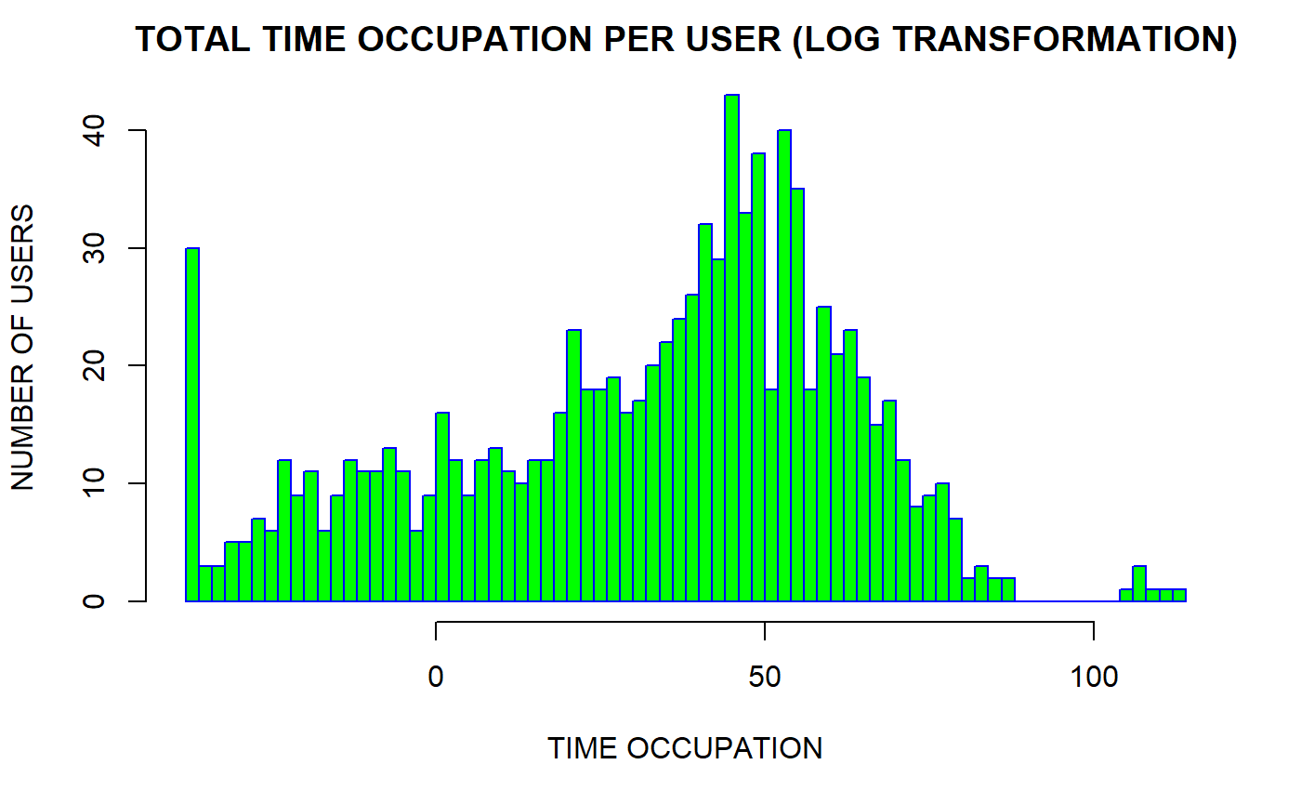

Slide 7
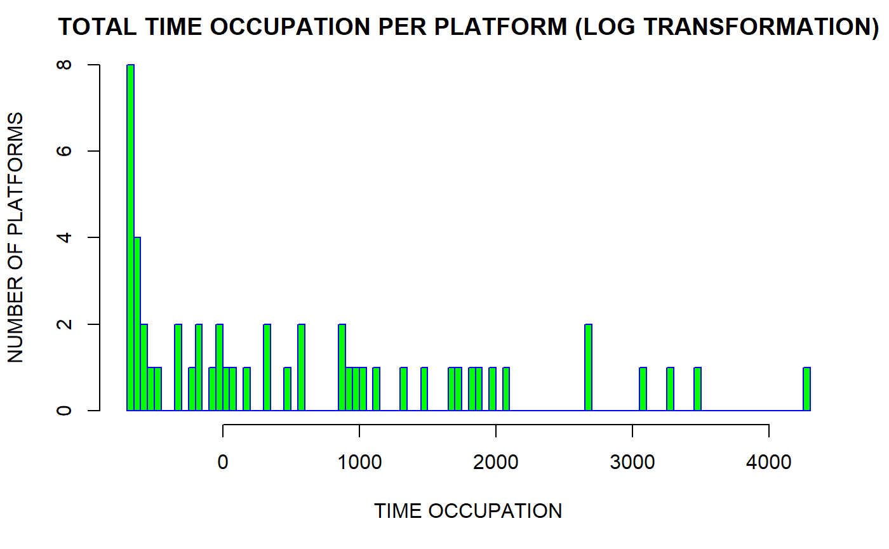

Slide 8
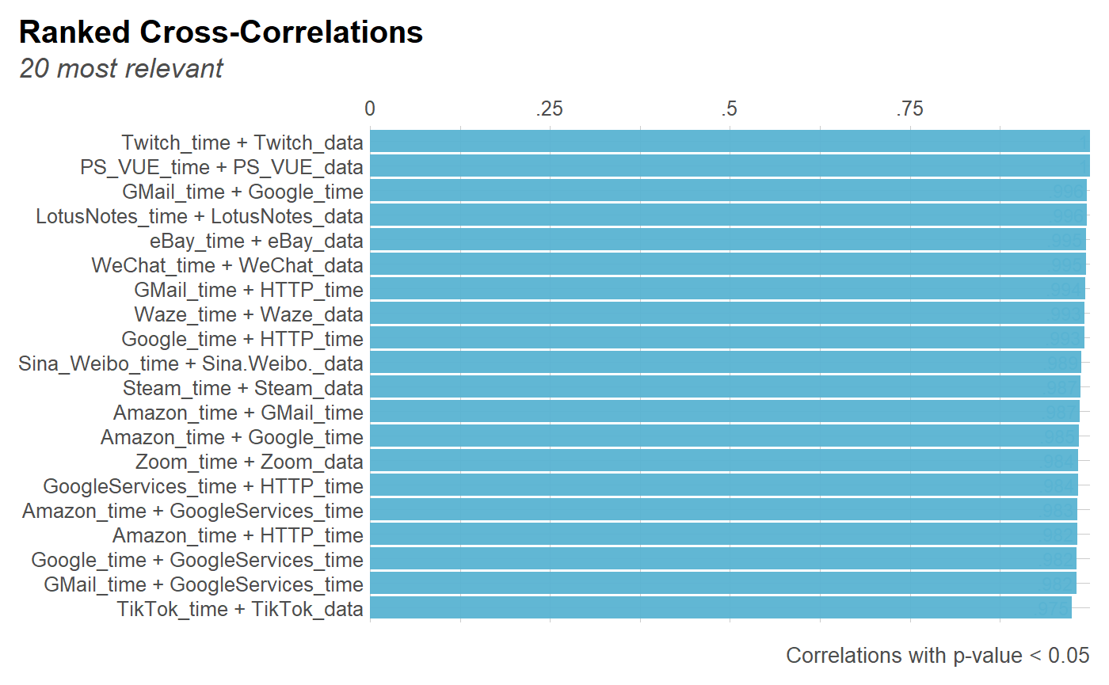

Slide 9
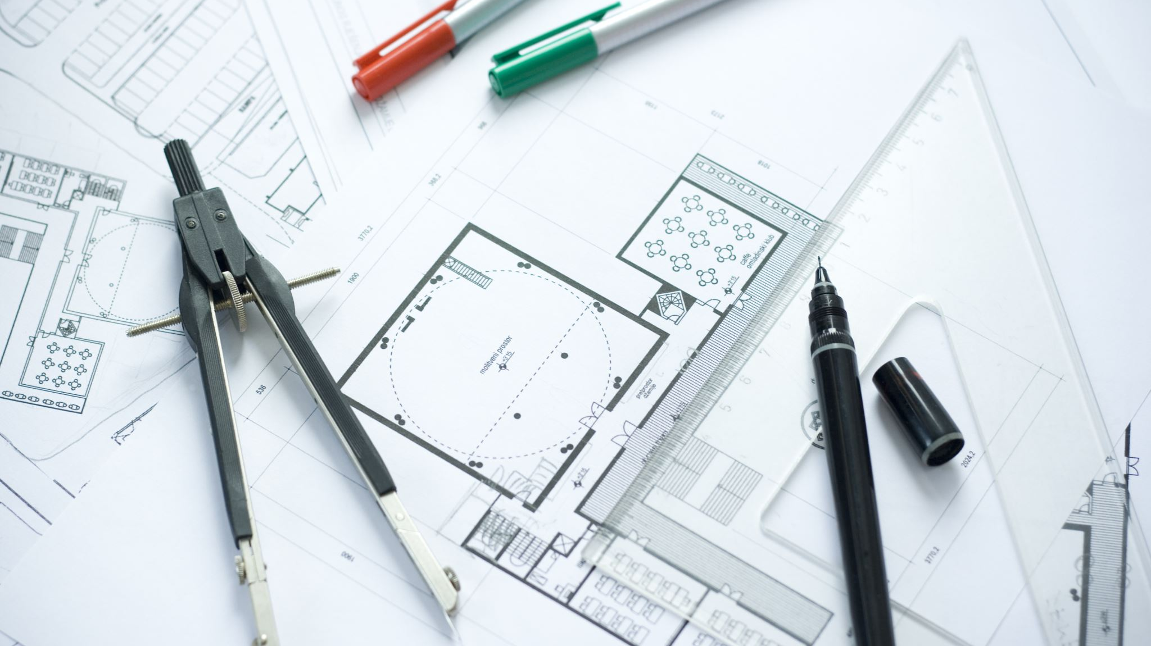
FEATURE ENGINEERING OVERVIEW

Slide 10
WE HAVE…
01
02
03
04
DELETED FEATURES RELATED TO DATA USAGE
DELETED FEATURES THAT CONTAINED LESS THAN TWO USERS’ ENTRIES
DELETED
DUPLICATED ENTRIES
PERFORMED LOG TRANSFORMATION DESCRIBED BEFORE

Slide 11

DATASET VISUALIZATION (PCA)

Slide 12
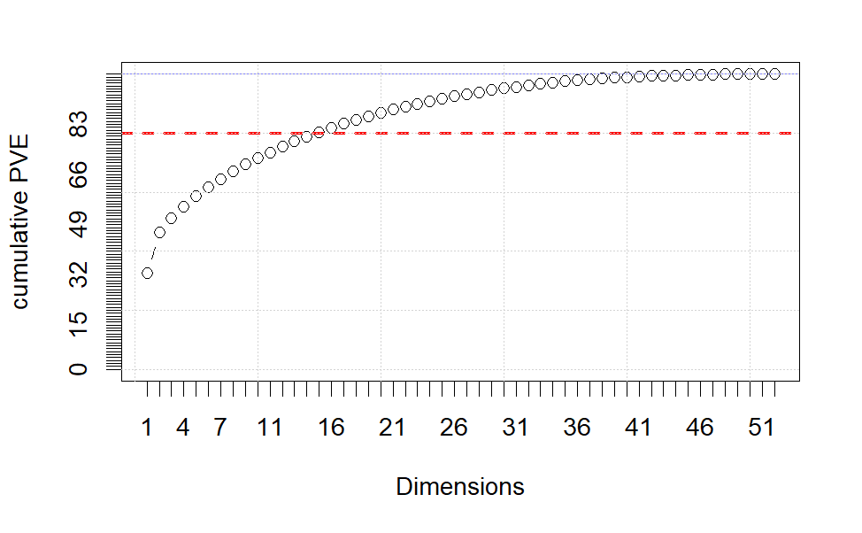
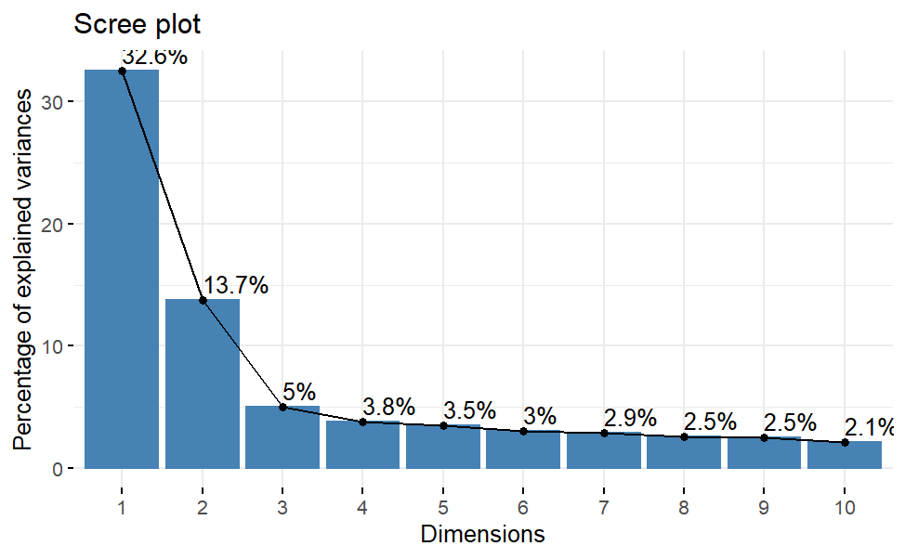
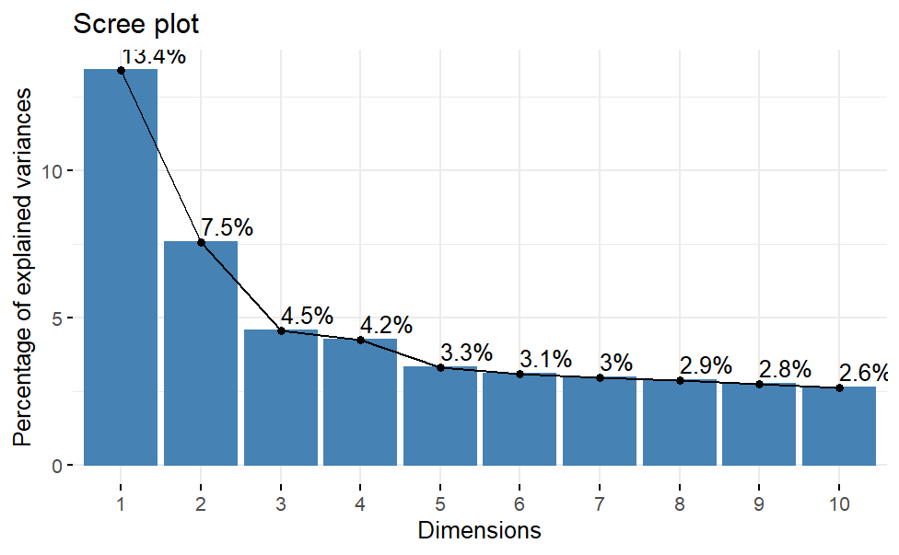
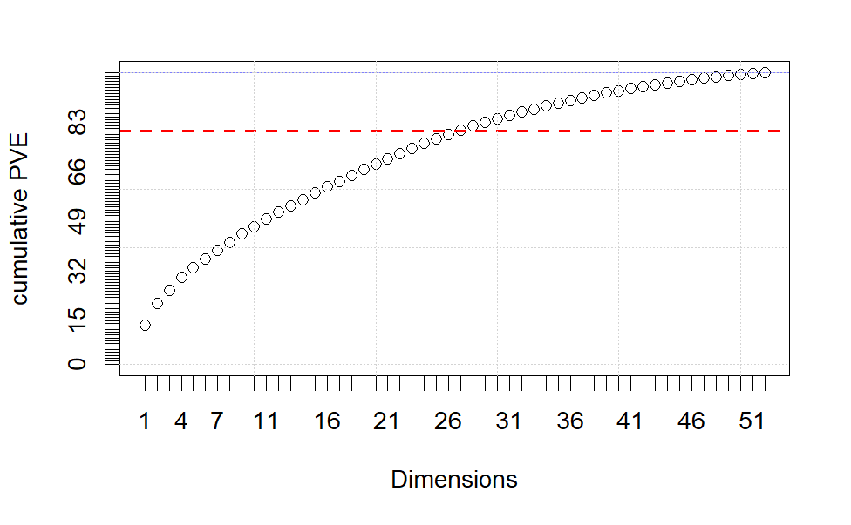
PCA
Log transformed data
Scaled data

Slide 13
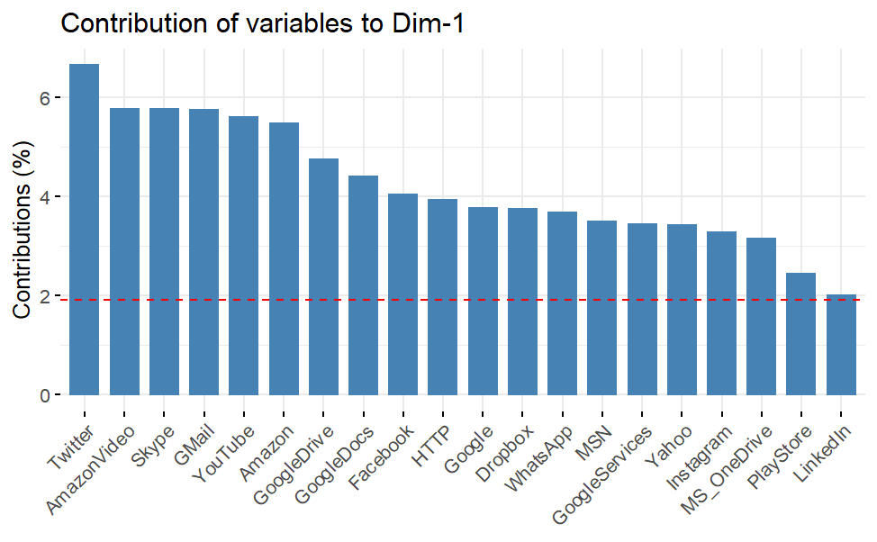
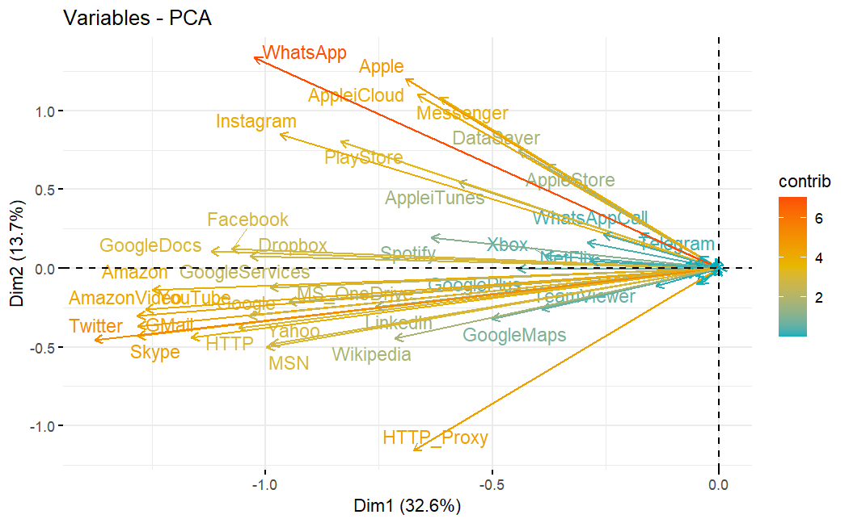
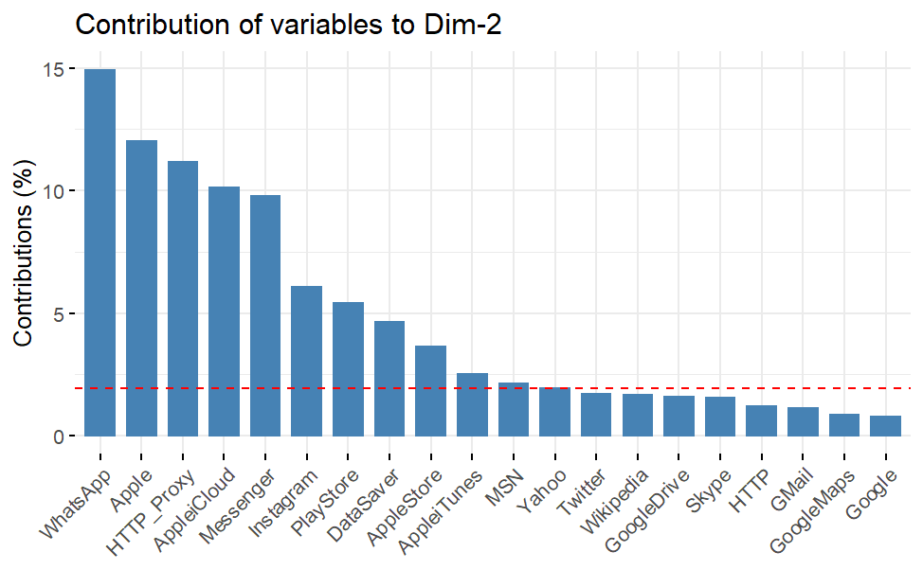
PCA

Slide 14
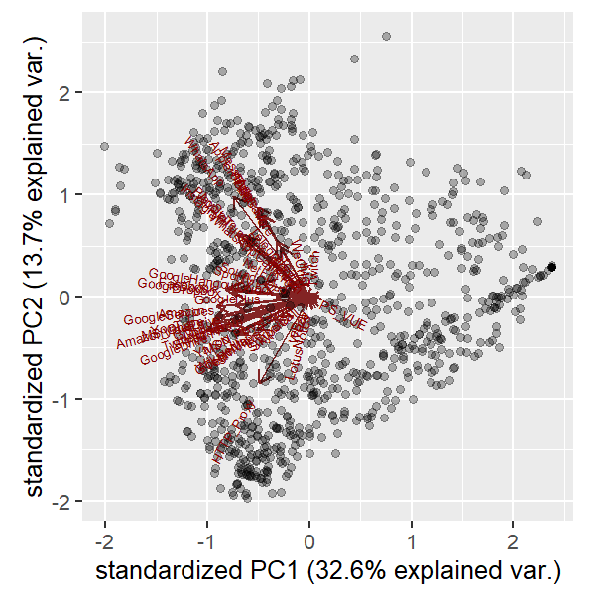
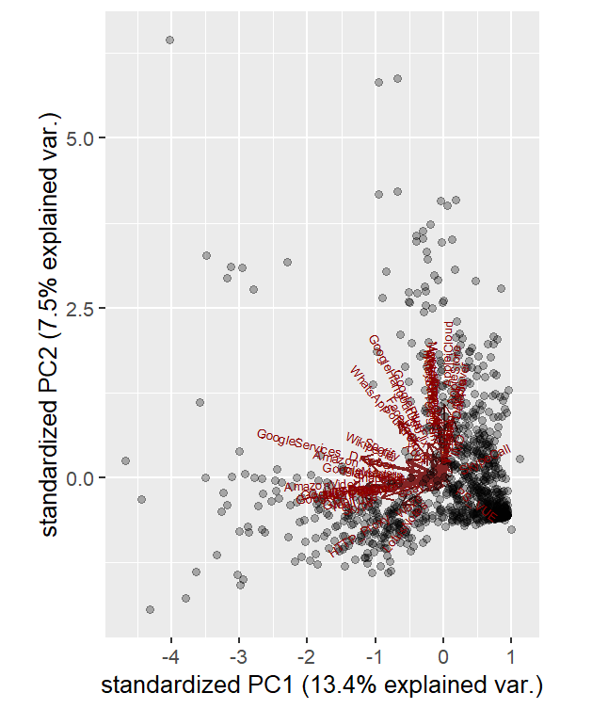
PCA
Log transformed data
Biplots
Scaled data

Slide 15
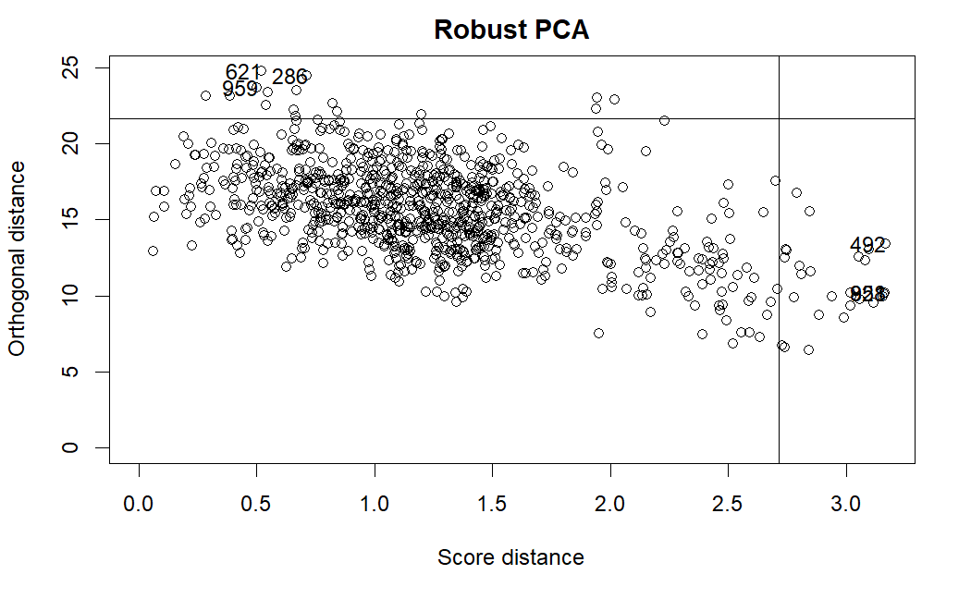
Robust PCA
Flags the outliers
First Two components

Slide 16
Robust PCA
Orthogonal outliners
Flags the outliers
Bad
leverage
First Two components
Regular points
Good leverage
(Chen et al., 2020)

Slide 17
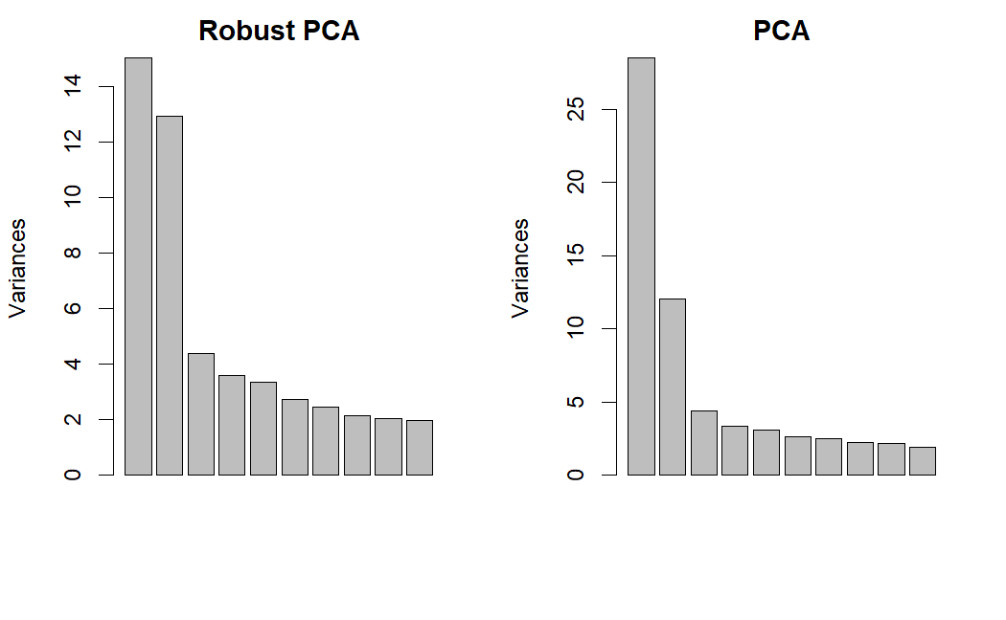
Variances Robust and Classic PCA

Slide 18
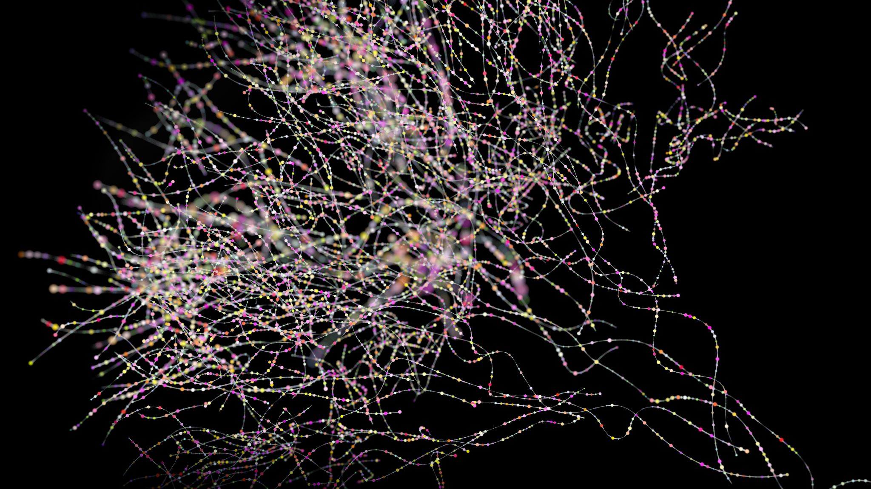
CLUSTERING

Slide 19
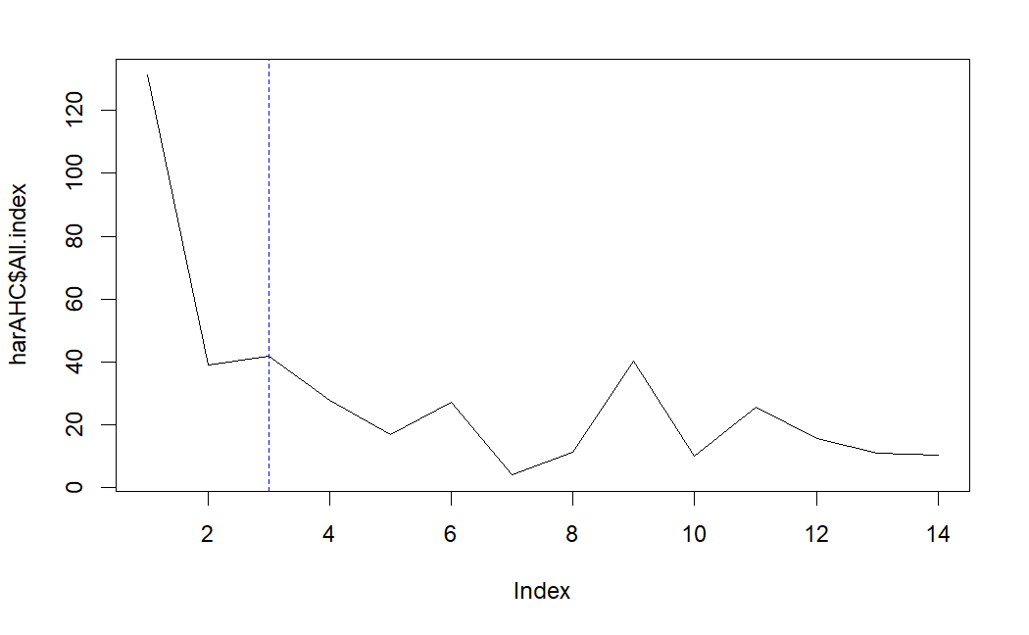
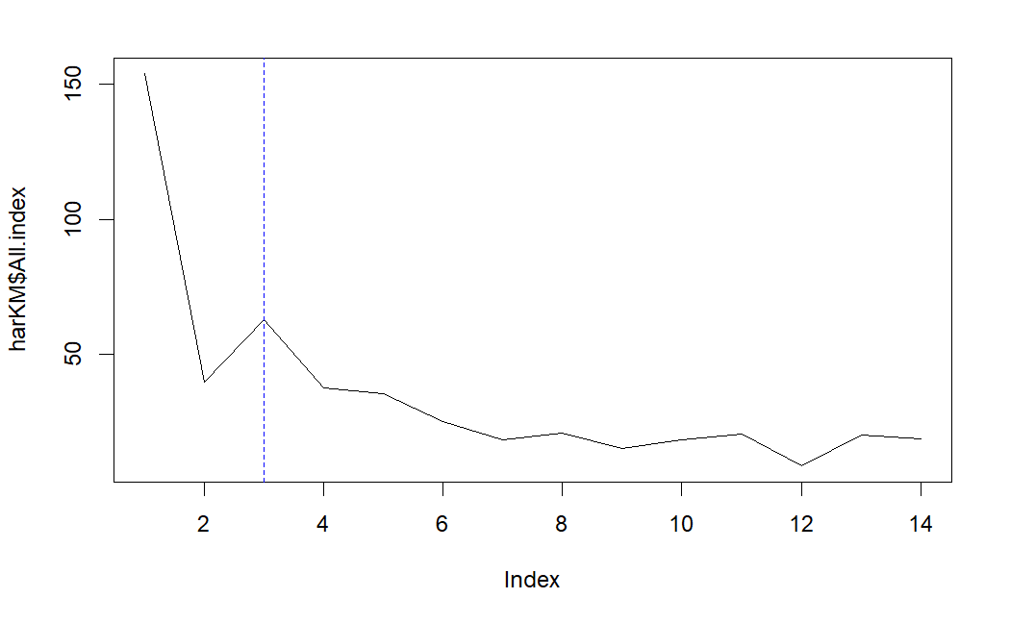
Clustering method selection
From a previous work (Rojas et al., 2020):
3/4 clusters - Low, Medium, High and Very High
Hartigan Index
Agglomerative Hierarchical clustering method
Kmeans clustering method

Slide 20
Evaluating Clustering methods
Cluster stability measure:
The average proportion of non-overlap (APN)
The average distance (AD)
The average distance between means (ADM)
The figure of merit (FOM)
APN | 0.009 | kmeans | 3
AD | 10.2 | kmeans | 4
ADM | 0.095 | kmeans | 3
FOM | 0.93 | kmeans | 4
Connectivity | 139.75 | hierarchical | 3
Dunn | 0.26 | hierarchical | 3
Silhouette | 0.20 | kmeans | 3
Internal measures for cluster validation

Slide 21
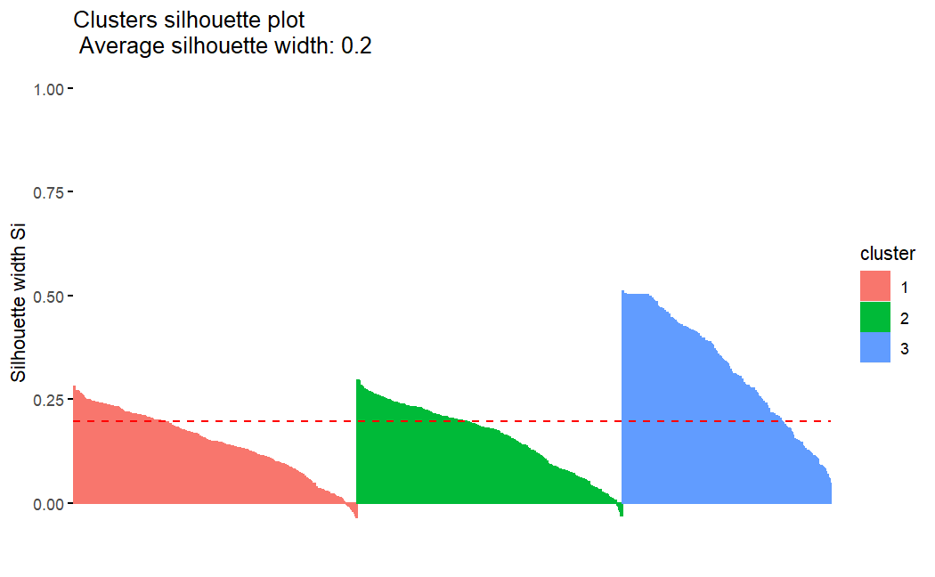
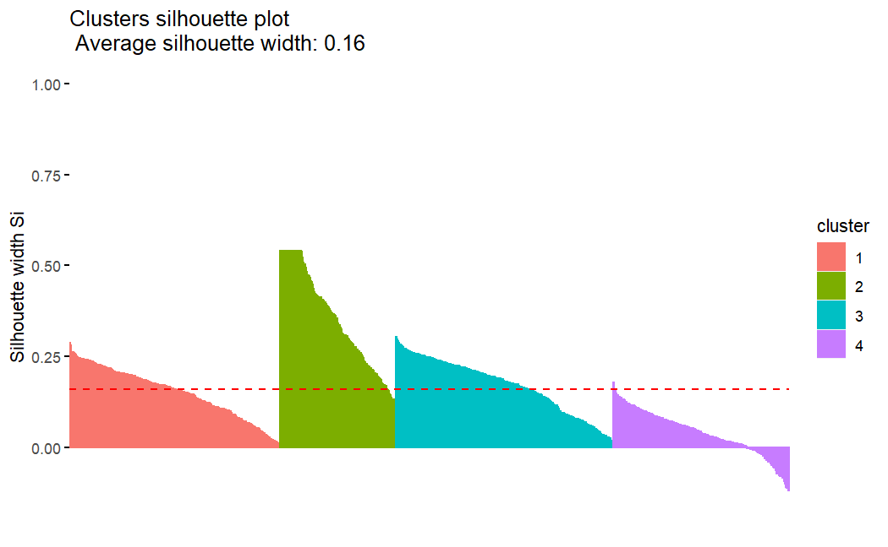
Evaluating a Clustering Solution
Silhouette widths kmeans

Slide 22
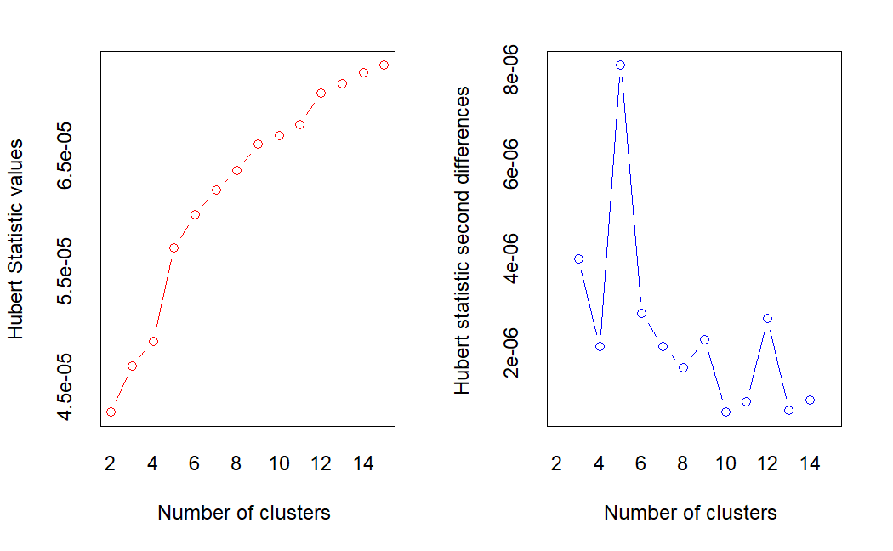
Evaluating a Clustering Solution
Hubert index kmeans
According to the majority rule, the best number of clusters is 3
* 11 proposed 3 as the best number of clusters
* 1 proposed 4 as the best number of clusters
* 9 proposed 2 as the best number of clusters

Slide 23
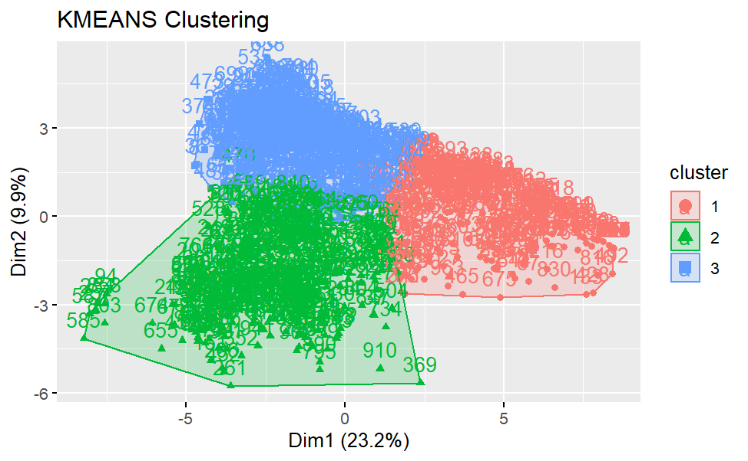
Kmeans 3 clusters
Size Clusters
1 | 2 | 3
266 | 343 | 364

Slide 24
Reference
Chen, X., Zhang, B., Wang, T., Bonni, A., & Zhao, G. (2020). Robust principal component analysis for accurate outlier sample detection in RNA-Seq data. BMC bioinformatics, 21(1), 1-20.
Metcalf, L., & Casey, W. (2016). Cybersecurity and applied mathematics. Syngress.
Rojas, J. S., Pekar, A., Rendón, Á., & Corrales, J. C. (2020). Smart user consumption profiling: Incremental learning-based OTT service degradation. IEEE access, 8, 207426-207442.
Forgy, E. W. (1965). Cluster analysis of multivariate data: efficiency vs interpretability of classifications. Biometrics, 21, 768–769.
Hartigan, J. A. and Wong, M. A. (1979). Algorithm AS 136: A K-means clustering algorithm. Applied Statistics, 28, 100–108. doi: 10.2307/2346830.
Lloyd, S. P. (1957, 1982). Least squares quantization in PCM. Technical Note, Bell Laboratories. Published in 1982 in IEEE Transactions on Information Theory, 28, 128–137.
MacQueen, J. (1967). Some methods for classification and analysis of multivariate observations. In Proceedings of the Fifth Berkeley Symposium on Mathematical Statistics and Probability, eds L. M. Le Cam & J. Neyman, 1, pp. 281–297. Berkeley, CA: University of California Press.

Slide 25
Reference
Charrad M., Ghazzali N., Boiteau V., Niknafs A. (2014). "NbClust: An R Package for Determining the Relevant Number of Clusters in a Data Set.", "Journal of Statistical Software, 61(6), 1-36.", "URL http://www.jstatsoft.org/v61/i06/".
Becker, R. A., Chambers, J. M. and Wilks, A. R. (1988) The New S Language. Wadsworth & Brooks/Cole.
Mardia, K. V., Kent, J. T. and Bibby, J. M. (1979) Multivariate Analysis. Academic Press.
Borg, I. and Groenen, P. (1997) Modern Multidimensional Scaling. Theory and Applications. Springer.

